Slide 1


CCGPS Mathematics
A beginner’s guide to
Number Talks
October 2013
Microphone and speakers can be configured by going to:
Tools – Audio – Audio setup wizard
Turtle Toms- tgunn@doe.k12.ga.us
Elementary Mathematics Specialist
These materials are for nonprofit educational purposes only.
Any other use may constitute copyright infringement.

Slide 2
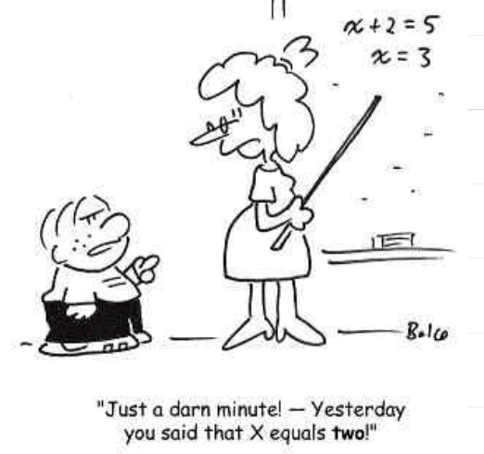
Notes:
Preview and welcome
-going to be really hard to talk about numbers when I can’t hear what your saying
Be sure to introduce the next slide and tell them they are going to do it mentally…

Slide 3
what is 45% of 63?
Notes:
Just kidding…but the anxiety that you just felt is what your students will probably experience the first time you ask them to mentally think about numbers and then share their solution strategy

Slide 4
mentally solve
85-29
Notes:
Solve this mentally

Slide 5
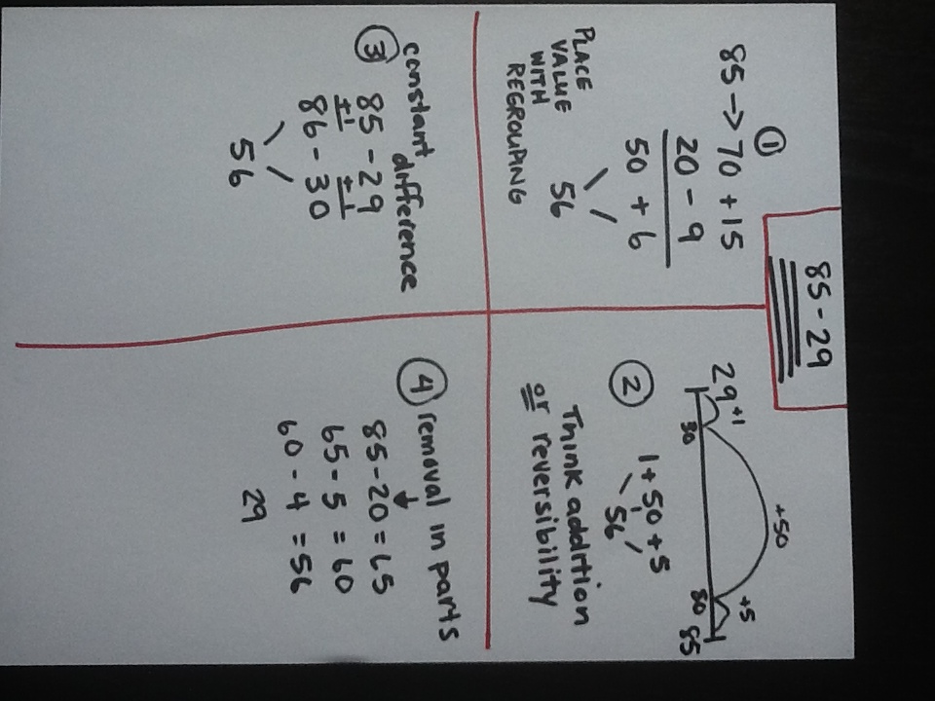
Possible solution strategies

Slide 6
What is Number Talks?
A Number Talk is a short, ongoing daily routine that provides students with meaningful ongoing practice with computation:
keep Number Talks short, as they are not intended to replace current curriculum or take up the majority of the time spent on mathematics.
spend only 5 to 15 minutes on Number Talks
Talks are most effective when done everyday.
Notes:
This is what is what Number Talks is not…
Push out Kid Snippet Video- www.youtube.com/watch?v=KdxEAt91D7k
Discussing that we are all guilty but the good thing is that you are here and your wanting to be a more effective teacher

Slide 7
Some questions to ask yourself…
What the goal of Number Talks?
What's the difference between computational fluency and memorization?
Why not use flash cards? or when should they be used?
Purposeful practice...what is it?
Notes:
Computational Fluency
What happens to the students that only has memory to think mathematically. Use 8x7 as an example…if the student doesn’t know 8x7 they would revert back to skip counting but the students that has learned through strategy could say I don’t know 8x7 but I know that 8x8 is 64 and 64-8 is 56.
Purposeful practice...what is it?
students can only become faster and more efficient at what they already know
why not use flash cards? or when should they be used?
Purposeful practice...what is it?

Slide 8
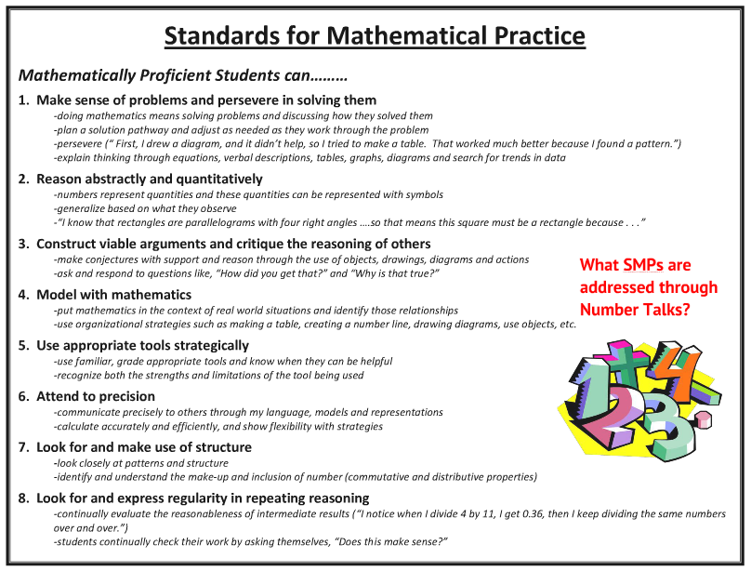
How does it connect to CCGPS?
Notes:
What SMPs are connected to Number Talks?
The only one I can say is SMP#4

Slide 9
What does Number Talks look like?
Students are near each other so they can communicate with each other (central meeting place)
Students are mentally solving problems
Students are given thinking time
Thumbs up show when they are ready
Teacher is recording students' thinking
Notes:
Communicate:
Having to talk out loud about a problem helps students clarify their own thinking
Allow students to listen to other's strategies and value other's thinking
Gives the teacher the opportunity to hear student's thinking
Mental Math:
When you are solving a problem mentally you must rely on what you know and understand about the numbers instead of memorized procedures
You must be efficient when computing mentally because you can hold a lot of quantities in your head
Thumps Up:
This is just a signal to let you know that you have given your students enough time to think about the problem
If will give you a picture of who is able to compute mentally and who is struggling
It isn't as distracting as a waving hand
Teacher as Recorder:
Allows you to record students' thinking in the correct notation
Provides a visual to look at and refer back to
Allows you to keep a record of the problems posed and which students offered specific strategies

Slide 10
Purposeful Problems
Start with small numbers so the students can learn to focus on the strategies instead of getting lost in the numbers
Use a number string (a string of problems that are related to and scaffold each other)

Slide 11
Purposeful Number Strings
7 + 19
16 +29
19 +18
29 +33
Notes:
What do you notice?
Lots of 9-ness which purposely lend itself to the make a ten strategy
And this really stinks because this is on tape delay…so if you’re right give yourself a Kindergarten “kiss your brain”

Slide 12
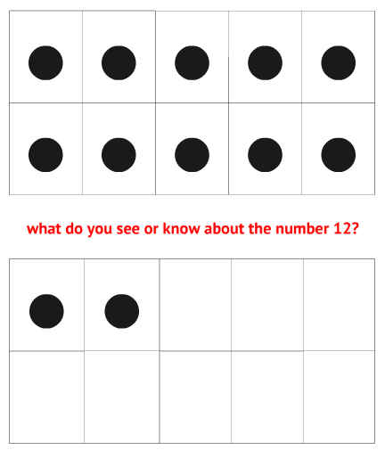
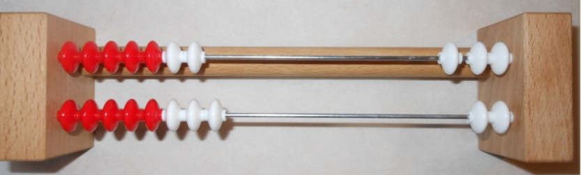
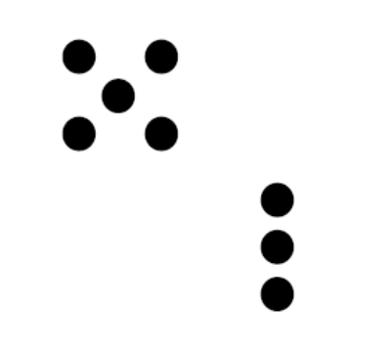
K-2 Number Talks
dot cards, ten frames, Rekenreks
Notes:
We want to move our students from Perceptual Subitizers to Conceptual Subitizers
Review what subitizing is for upper grades and discuss the difference between perceptual and conceptual
Perceptual see 5 dots and that all they know
Conceptual sees 5 dots and they can articulate and explain how they see the 5 dots (a group of 2 and a group of 3)

Slide 13
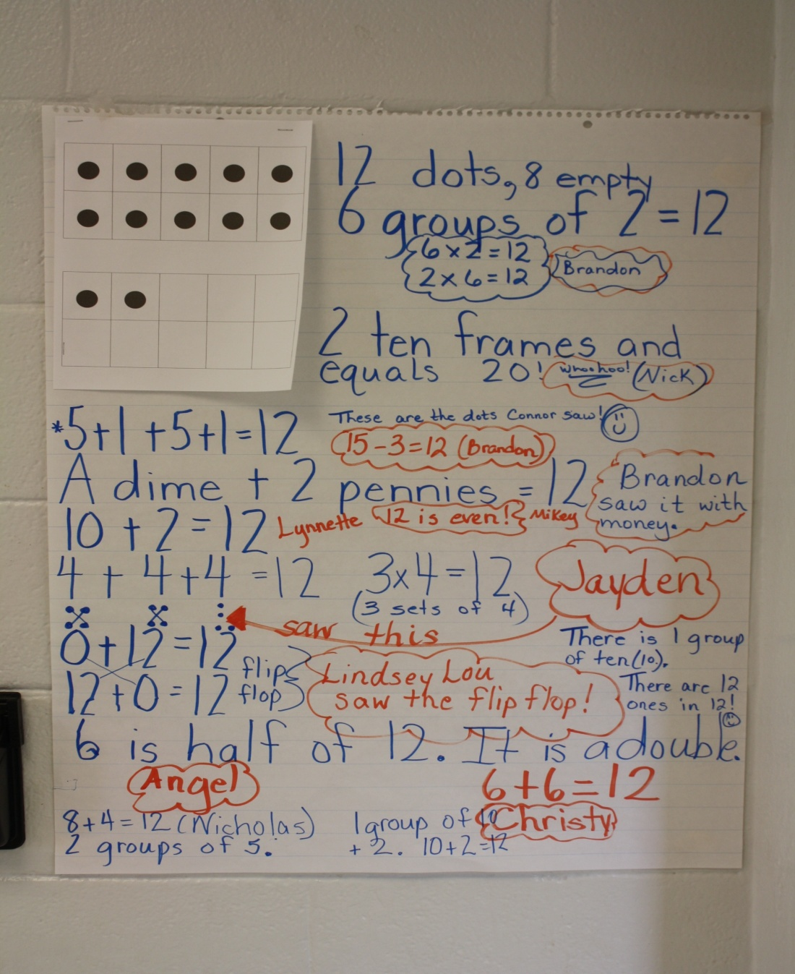
What first grade students see in the number 12☺
Notes:
Thank you Ms. Burge

Slide 14
Number Talks in 1st Grade
Add and subtract within 20, demonstrating fluency for addition and subtraction within 10. Use strategies such as counting on; making ten (e.g., 8 + 6 = 8 + 2 + 4 = 10 + 4 = 14); decomposing a number leading to a ten (e.g., 13 – 4 = 13 – 3 – 1 = 10 – 1 = 9); using the relationship between addition and subtraction (e.g., knowing that 8 + 4 = 12, one knows 12 – 8 = 4); and creating equivalent but easier or known sums (e.g., adding 6 + 7 by creating the known equivalent 6 + 6 + 1 = 12 + 1 = 13).
Notes:
Review the standard quickly and then push out video to show how Number Talks connects to standards.
Push out video…http://www.youtube.com/watch?v=eijmcqGe61o

Slide 15
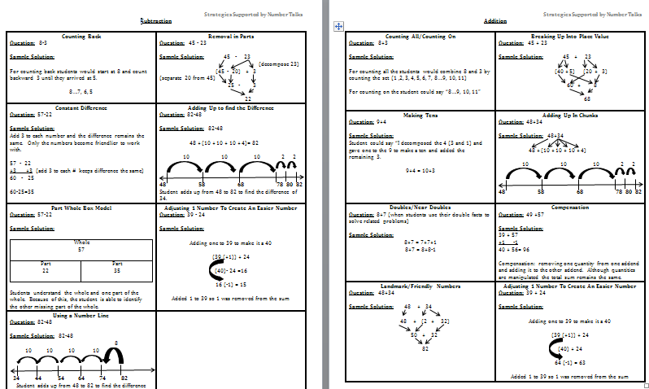
Building Computational Fluency
Notes:
Undoing parent misconceptions….send this home. We pushed it out at the beginning and we’ll post it to the wiki. We need to continue to educate parents because we are educating them as well.
I hate it when we spend all day exposing students to understanding numbers and then we send them home and they return back the next day to find out their parents showed them and “easier way”.

Slide 16
What could it look like in 3rd through 8th grade?
Multiplication and division
Decimals (same part-whole additive strategies but extended to rational numbers…good stuff!)
Fractions (context for learning-Fosnot)

Slide 17
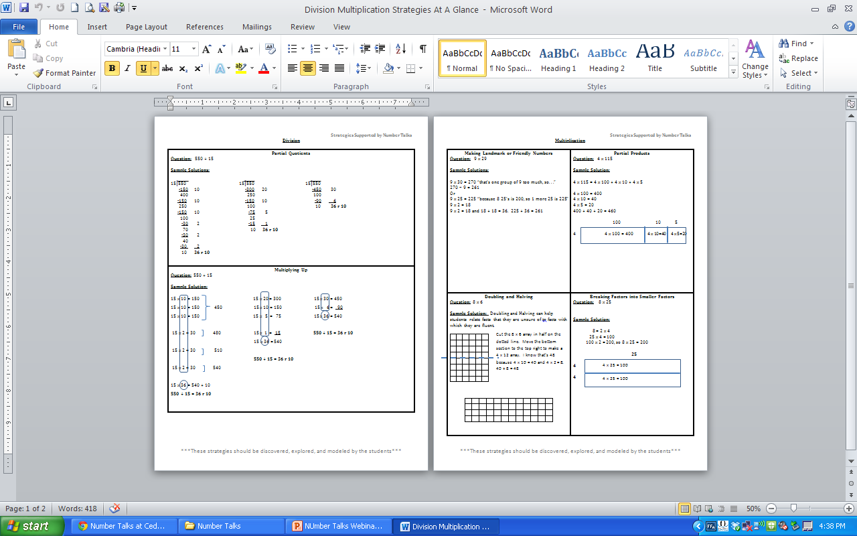

Slide 18
STUDENT ACCOUNTABILITY WITH NUMBER TALKS
Students use finger signals to indicate most efficient strategy.
Keep records of problems posed and student strategies.
Hold small-group number talks.
Create and post class strategy charts.
Give students an exit problem using the discussed strategies.

Slide 19
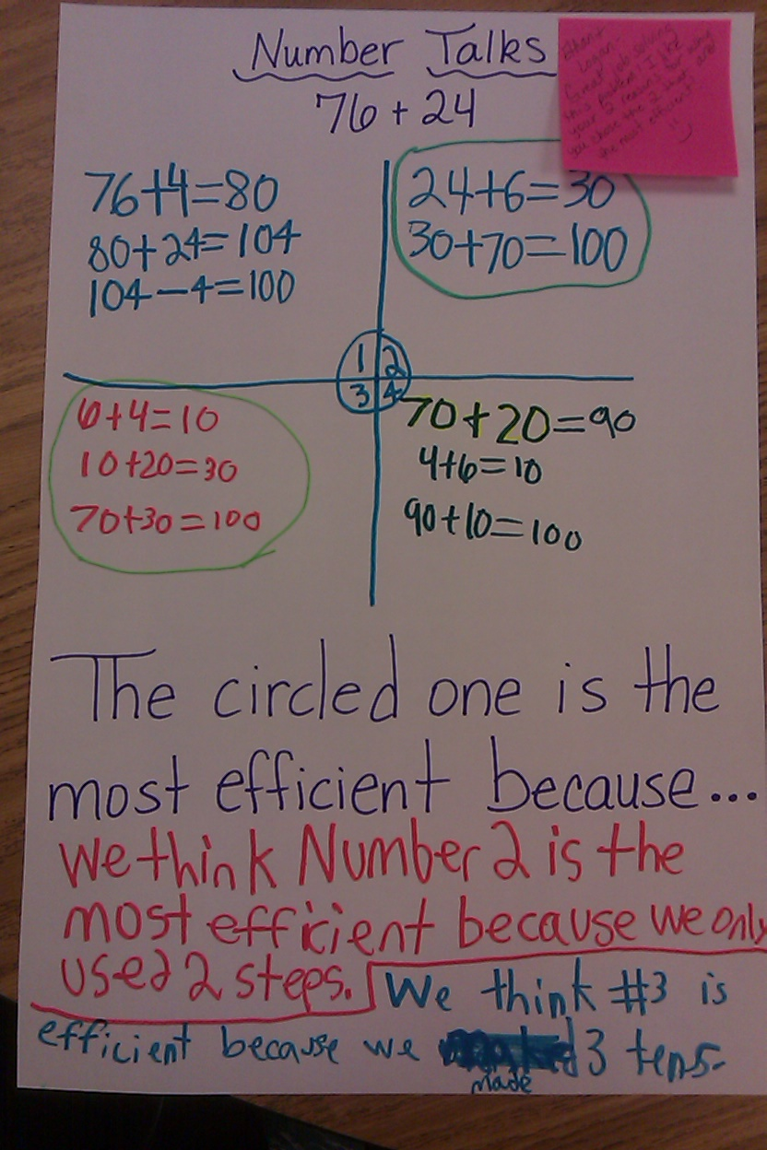
Connecting Number Talks to classroom tasks
Notes:
Thanks Shelly Burch for Sharing…..discuss how Shelly uses this with her 3rd grade classroom.

Slide 20
Starting Number Talks in your Classroom
Start with specific problems in mind
Be prepared to offer a strategy from a previous student
It is ok to put a student's strategy on the backburner
Limit your number talks to about 15 minutes
Ask a question, don't tell!

Slide 21
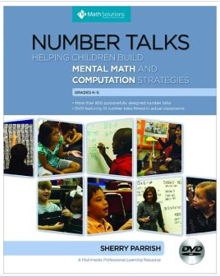
Number Talks
Don’t have the book?
Look and learn here:
http://insidemathematics.org/index.php/number-talks
http://www.mathperspectives.com/num_talks.html
http://www.mathsolutions.com/index.cfm?page=wp10&crid=553
http://schoolwires.henry.k12.ga.us/Page/37071
http://www.cobbk12.org/bullard/NumberTalksK-2.pdf
Notes:
Number Talks book by Sherry Parrish, or if you don’t have the book, here are links to free resources.

Slide 22
RESOURCES
http://insidemathematics.org/index.php/number-talks
http://www.mathperspectives.com/num_talks.html
http://www.mathsolutions.com/index.cfm?page=wp10&crid=553
http://schoolwires.henry.k12.ga.us/Page/37071
http://www.cobbk12.org/bullard/NumberTalksK-2.pdf
http://numberstrings.com/

Slide 23
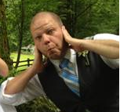
Who’s keeping it real? This guy.
Graham Fletcher
http://gfletchy.wordpress.com/2013/10/29/no-numerals-allowed-in-math-class/
@gfletchy
Notes:
Thanks, Graham, for your invaluable input and advice. Keeping it real.

Slide 24
Thank You!
Please visit http://ccgpsmathematicsk-5.wikispaces.com/ to share your feedback, ask questions, and share your ideas and resources!
Please visit https://www.georgiastandards.org/Common-Core/Pages/Math.aspx to join the K-5 Mathematics email listserve.
Follow on Twitter!
Follow @GaDOEMath
Turtle Toms
Program Specialist (K-5)
tgunn@doe.k12.ga.us
These materials are for nonprofit educational purposes only. Any other use may constitute copyright infringement.

